Slide 1



Scalable Distributed Reinforcement Learning in Multi-Agent Environments
Tamás Takács
Gergely Magyar
Presenters
Computer Science MSc
ELTE - Faculty of Informatics
Supervisor | László Gulyás
Associate Professor, Department of Artificial Intelligence
Deputy Director, Institute for Industrial-Academic Innovation
ELTE - Faculty of Informatics
Budapest, 2024
Image courtesy of Source [1]
Notes:
TODO
Greet the board and the audience.
Introduce both of ourselves.
What are we presenting
Name of Supervisor

Slide 2
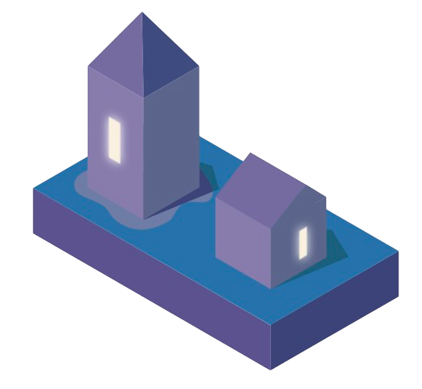

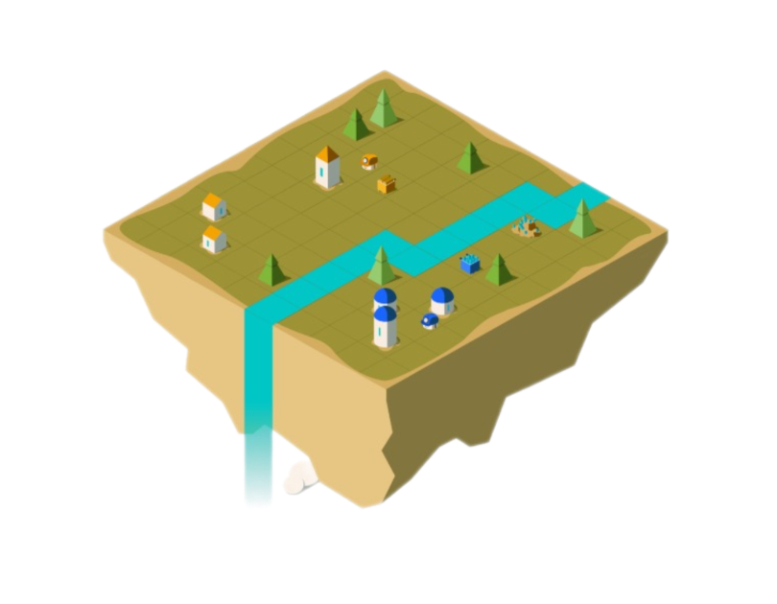
What is a Multi-Agent Reinforcement Learning Environment?
Entities
Entities
Cooperation
Rewards
Rewards
Actions
Actions
Environment
Introduction - Foundation
01/15
Image courtesy of Source [1]
Notes:
TODO
Before getting into too heavy details about the research, ..specify simple terms
Learning entities -interaction, coop trough actions in a 2D 3D env.
Trough these actions, these entities are rewarded and aligned..
An example for such an environment is….

Slide 3
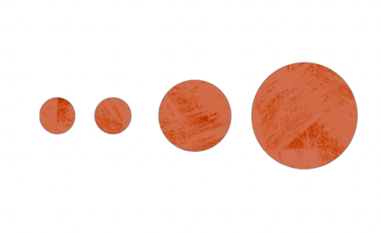
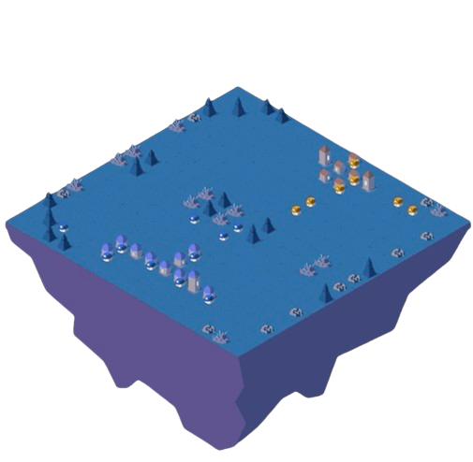



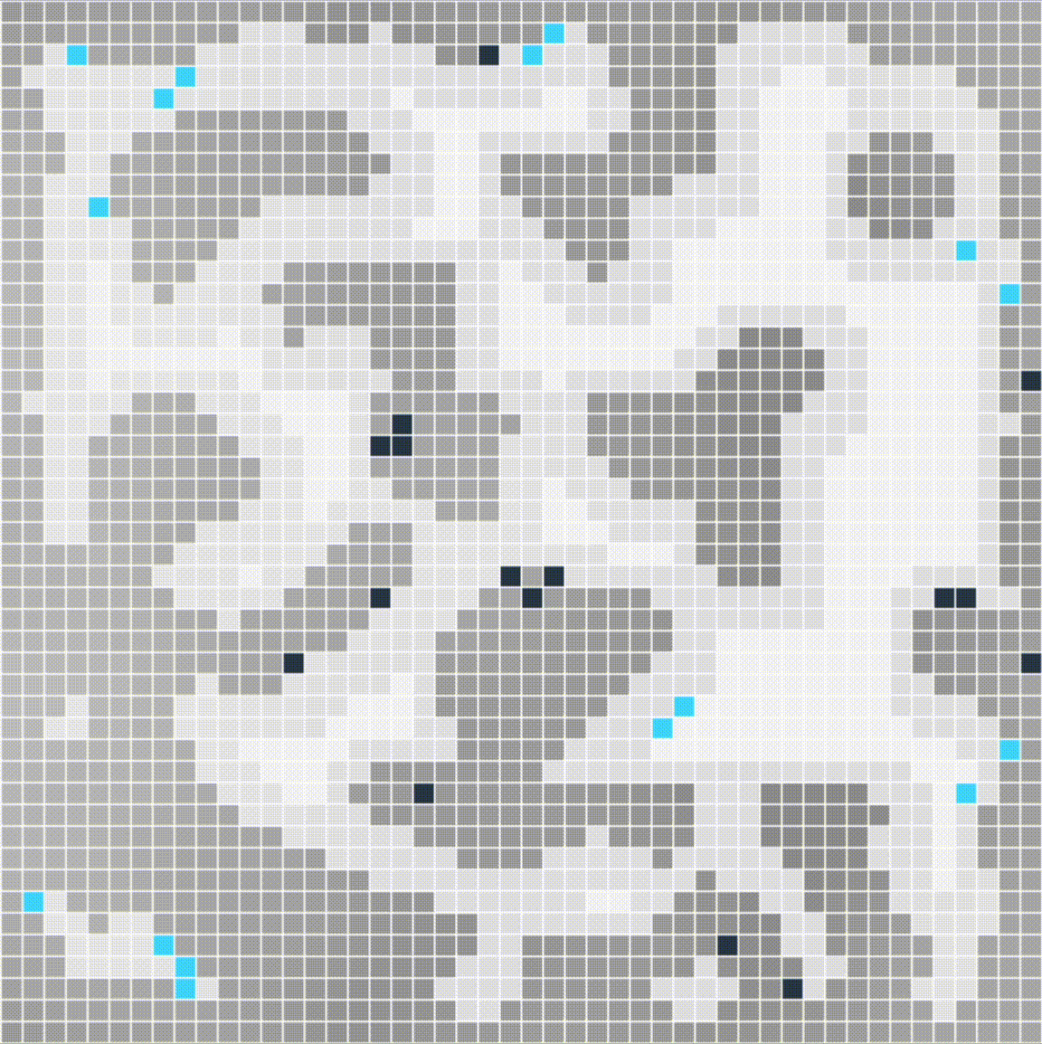




The Lux AI Challenge [1]
Season 1 [2]
Season 2 [3]
$10,000
$55,000
Bidding Phase
Factory Placement Phase
Factories
Unit Generation
Resource Collection
Win Condition
(Lichen Watering)
Introduction - Environment
02/15
Image courtesy of Source [2] and [3]
Notes:
TODO
Lux env, talk about the goa
Show gif, explain what can be seen.
Basic loop of the game
Season iterations

Slide 4
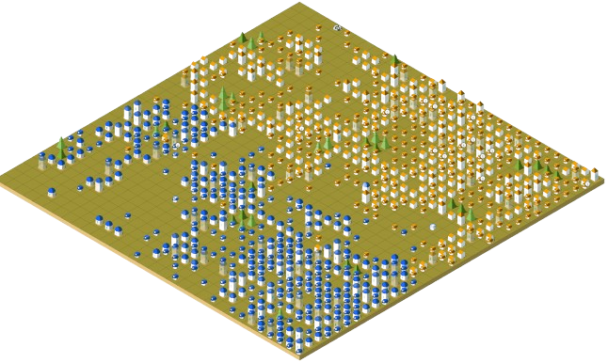
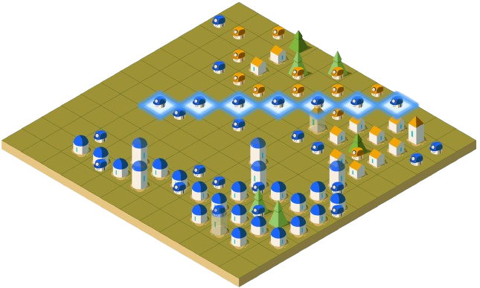

True Multi-Agent Solutions are Hard to Scale
Lux Env Complexity
Multiple teams
Multiple entity types
Massive entity numbers
Rapidly changing controllable entity numbers
Resource Requirements
Best RL submission trained for ~1 month [4]
Implementation Difficulties
No standard algorithm for MARL [5]
What is an agent?
Introduction - Problems
03/15
Image courtesy of Source [8]
Notes:
Motivation for the project… title
Why is it evident for lux
Best RL submission was trained for an extremely long time
Other impl difficulties.
What is an agent? A collection of units, one unit, a cluster, the whole team?

Slide 5
Project Overview
Contributions
1.
2.
3.
Single-Unit Benchmark Study
Centralized Model Architecture (Single-Agent)
Novel Agent Control Architecture
(Hybrid Approach)
Introduction - Goals
04/15
Notes:
Our core contributions are threefold
Say that we conducted extensive ablations studies as well
Providing a general guideline for building MA systems

Slide 6
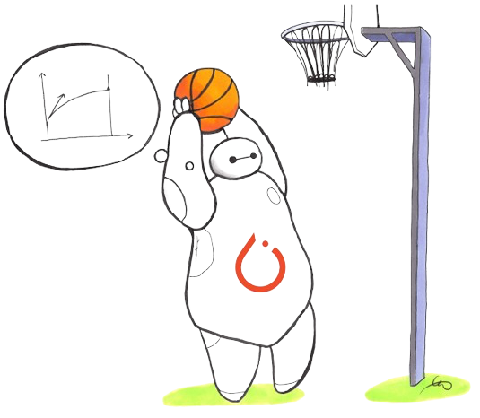
1.
Single Unit Benchmark Study
Setup
Algorithms
Single unit in the environment
Factories are heuristic
No self-play
Limited action space
Limited observation space
Limited goals
Stable Baselines 3 [6]
Value-Based Methods
Policy-Gradient Methods
Evolutionary Algorithms
Deep Q-Network
(DQN)
Advantage Actor-Critic
(A2C)
Proximal Policy Optimization
(PPO)
Trust Region Policy Optimization
(TRPO)
Quantile- Regression DQN
(QR-DQN)
Recurrent PPO
(R-PPO)
Maskable PPO
(M-PPO)
Augmented Random Search
(ARS)
Methods - 1. Single Unit Benchmark Study
05/15
Image courtesy of Source [6]
Notes:
Our first is the ….
Single unit in the environment
Tested 8 algorithms, we did this so…

Slide 7
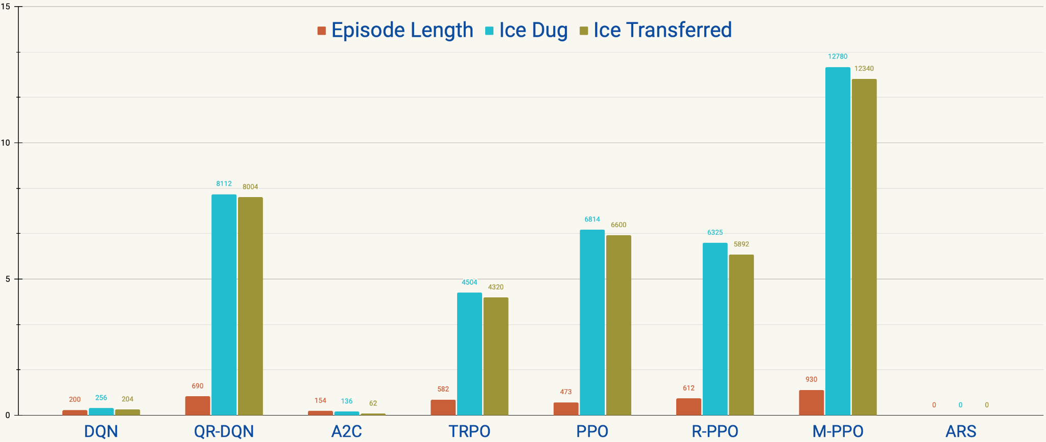
1.
Single Unit Benchmark Study
Evaluation Results
Metrics
Episode Length
(factory sustainability)
Count (x 1,000)
Ice Transferred
(resource allocation)
Ice Dug
(resource collection)
M-PPO
Algorithms
Results - 1. Single Unit Benchmark Study
06/15
Notes:
We evaluated these algos on 3 key metrics, out of which the most important being ep length
Tell other metrics as well
M-PPO performed better in all three metric.
We use it for subsequent studies.

Slide 8
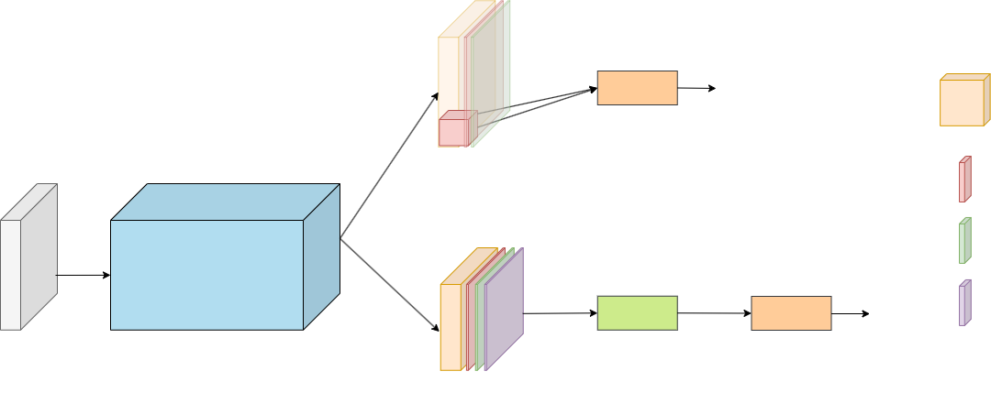
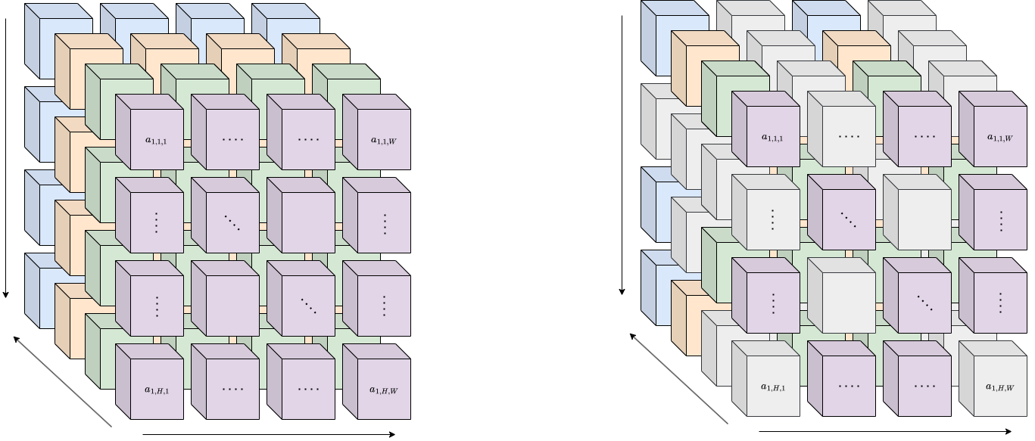
2.
Centralized Model Architecture
Setup
Network Architecture
1 x 16
Linear
Logits
3 x 3 Convolutional Layer with Spectral Norm
Multiple units in the environment
One agent (global)
No self-play
Full action space
CNN observation space
Limited goals
Stable Baselines 3 [6]
all features
(observation)
48 x 48 x 16
16 -> 16
1 x 16
Batch Normalization
Feature Extractor Network
Leaky ReLU Activation
48 x 48 x 16
Global Average Pooling Layer
Flatten
Linear
Value
48 x 48 x 16
48 x 48
1 x 2304
1 x 1
Action Space
w/o Action Masking
w/ Action Masking
H = 48
H = 48
|A| = 16
|A| = 16
W = 48
W = 48
Methods - 2. (Centralized)
07/15
Image courtesy of Source [6]
Notes:
Global, single agent view of the problem, global obs, global reward
Single value head for the entire state space and a critic that produced an action tensor for each pixel on the map- 3D tensor
Multi Agent → Multi Action
Critic Value Head gives a global value, Actor Head returns a global action tensor for every pixel
Changing Entity numbers not a problem
Bottleneck representation is hard

Slide 9
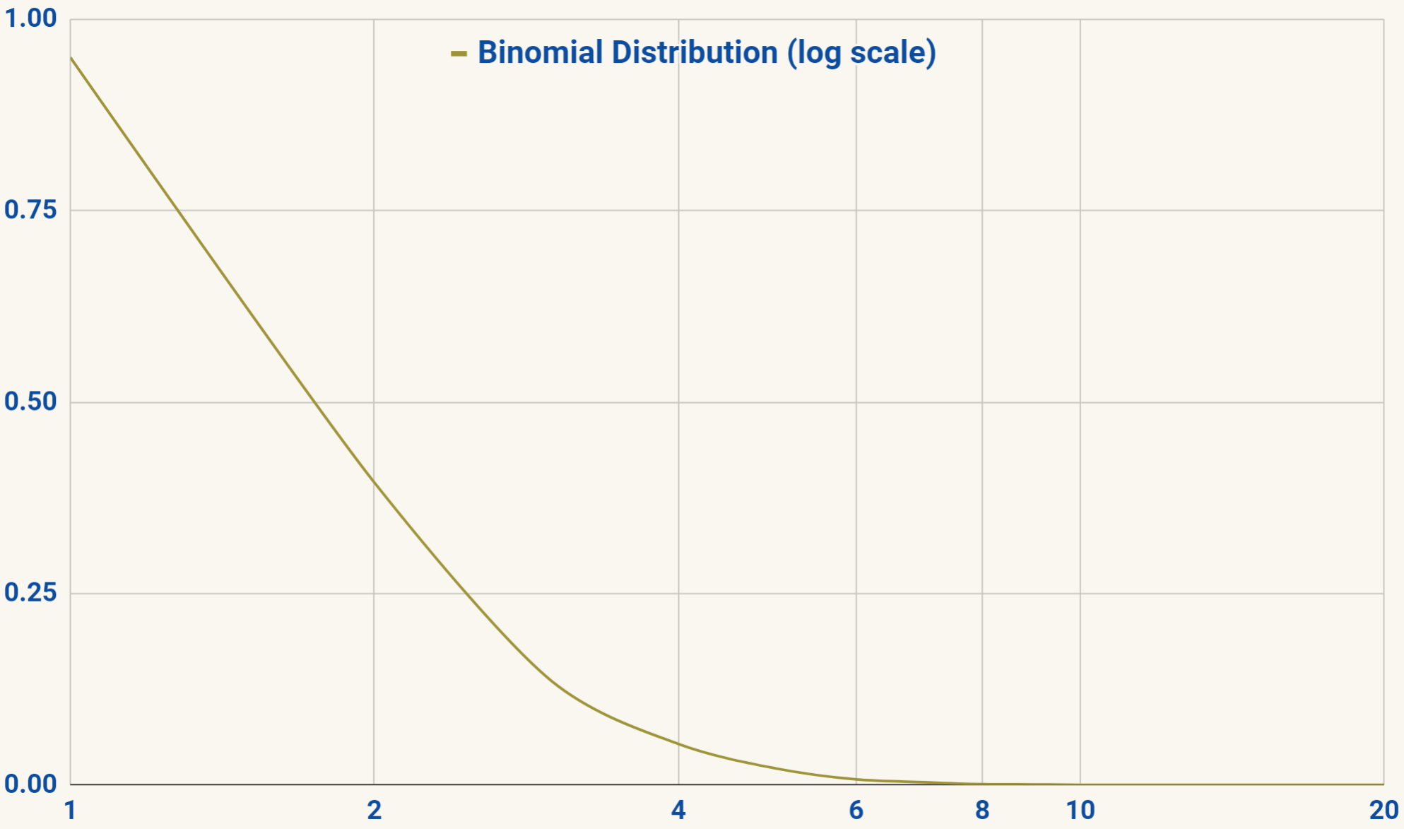
2.
Centralized Model Architecture
Why only a baseline?
Reinforce disadvantageous behavior - Punish beneficial behavior
Reinforce posthumously - Inherit legacy
Probability of at least ½ of Agents Behaving Advantageously
…or
Probability
PARADOX
Probability of at least ½ of agents behaving advantageously with 30 units is equivalent to winning the lottery 6 times in a row.
Agent Number
Methods - 2. (Centralized)
08/15
Notes:
Single Reward → During the training phases it is impossible to know which entity’s action contributed to that reward value
Because of this, there is a high chance that disadvantageous behaviors get reinforced along with the beneficial action
Or the small or negative rewards from the incorrect actions can dominate the final value, also punishing the few beneficial actions
This can make training unstable

Slide 10
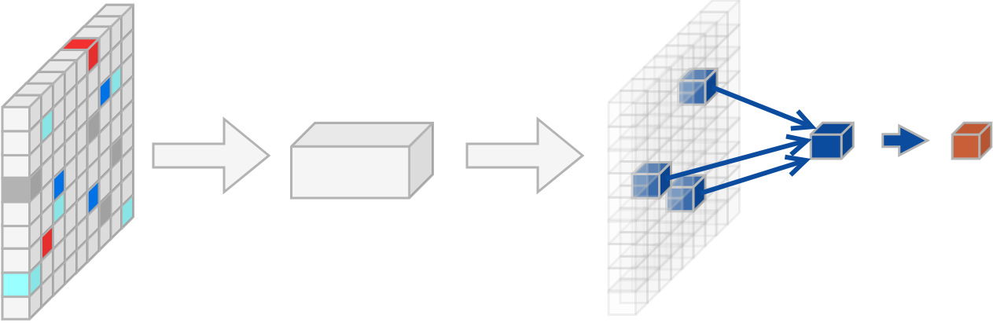
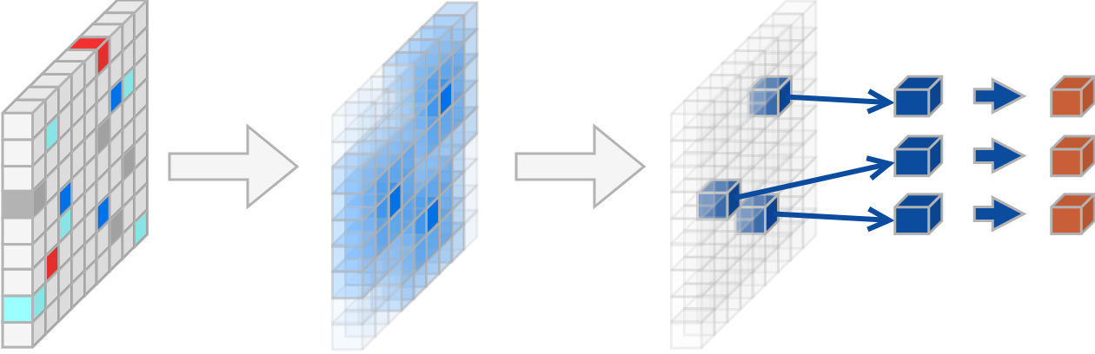
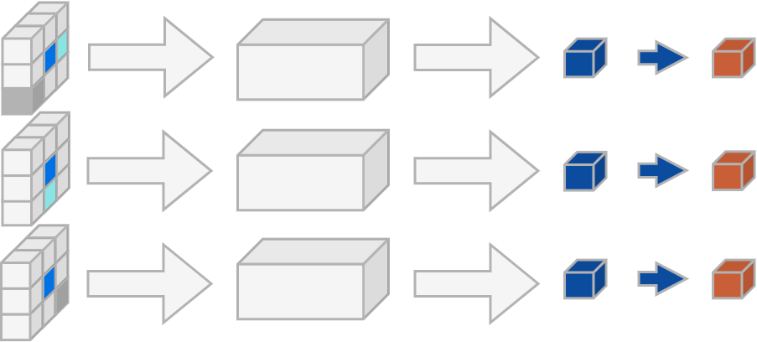
Hybrid Approach
3.
Comparison of Methods
Centralized (Single-Agent)
Hybrid
(Hybrid Multi-Agent)
Distributed (True Multi-Agent)
Global Reward Assignment
Distributed Reward Assignment*
Distributed Reward Assignment
Global Information
Global & Local Information
Local Information
Handles Changing Entity Count
Handles Changing Entity Count
Cannot Handle Changing Entity Count
Game State Representation
Reward
Rewards
Global
Observation
Action
Global Observation
Shape Preserving Game State Representation
Actions
Actions
Rewards
Local
Observations
Game State Representations
Methods - 3. (Hybrid)
09/15
*with Our Trajectory Separation Method
Notes:
We already talked about the centralized model
On the other end of the spectrum is the distributed approach, where each entity can be treated as a separate agent, with its own separate trajectory
Problems
Not resource efficient
Entity numbers, which can scale up to massive numbers and can change at every single step make vectorizing these trajectories difficult
Instead: hybrid approach, mixture of the two, 2 improvements over the centralized model

Slide 11
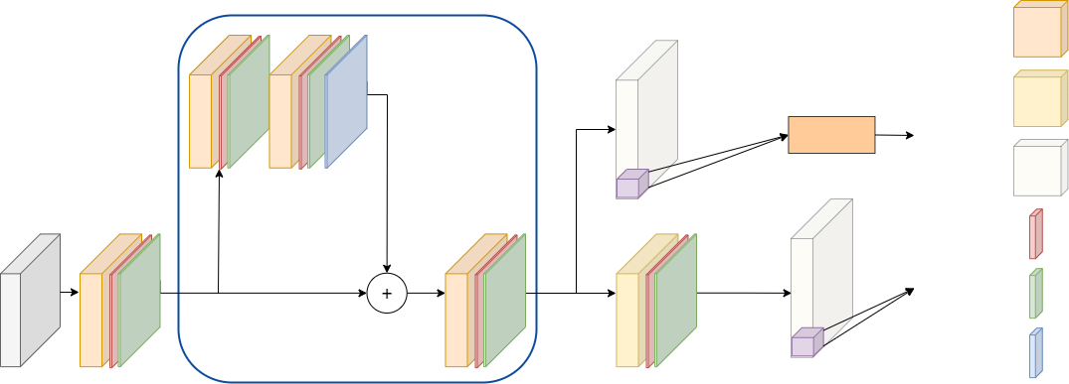
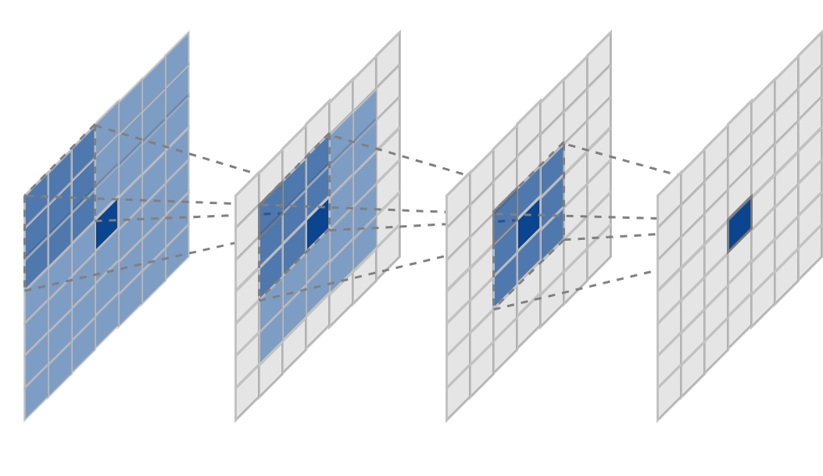
Hybrid Architecture
3.
Better Game State Representation
Network Architecture
Shape Preserving Residual Layer x3
Setup
3 x 3 Convolutional Layer with Spectral Norm
1 x 1 Convolutional Layer with Spectral Norm
1 x 16
Linear
Logit
Multiple units in the environment
Multiple agents (all entities)
No self-play
Full action space
CNN observation space
Limited goals
Own implementation
16 -> 16
1 x 16
Identity Layer
48 x 48 x 18
48 x 48 x 18
Batch Normalization
Critic Value
48 x 48 x 18
48 x 48 x 18
48 x 48 x 18
Leaky ReLU Activation
Squeeze-and-Excitation
48 x 48 x 18
Benefits
Field of View
Local Game State Representation
Global Field of View
Communication Channel
Methods - 3. (Hybrid)
10/15
Notes:
First improvement: better game state representation
We still use a centralized model, Instead of relying on a bottleneck, we can use a model that preserve the shape of the board at all layers and with it, the entities’ neighborhoods. This way the entity actions can be generated based on local information, but they can also access global information with repeated convolution operations.

Slide 12
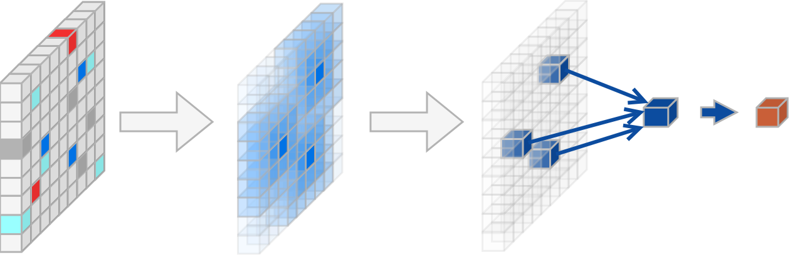
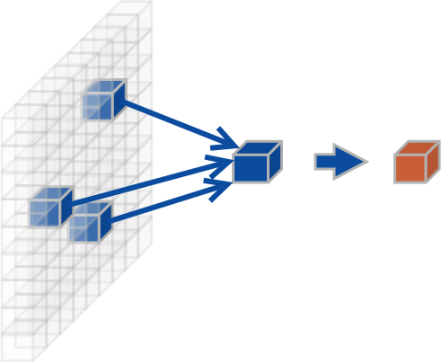
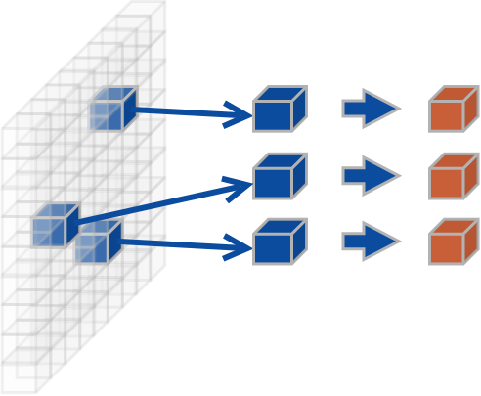
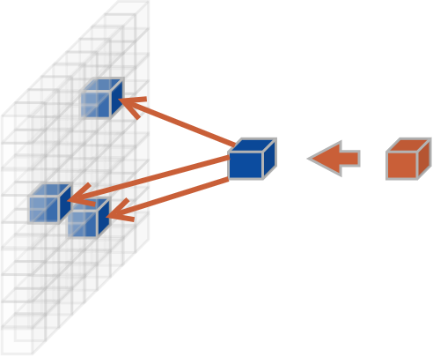
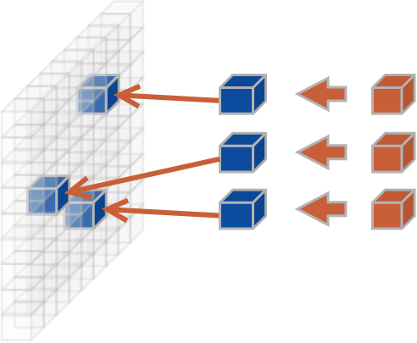
Trajectory Separation
3.
Better Reward Assignment
Hybrid w/o T.S.
Hybrid w/ T.S.
Global Reward
Single Trajectory
Single-Agent
Loss Based on Total Performance
Distributed Rewards
Trajectory per Entity
Multi-Agent
Loss Based on Individual Performance
Composite Action
Reward
Actions
Rewards
Gradients
Loss
Gradients
Loss
Methods - 3. (Hybrid)
11/15
Notes:
The second, most significant improvement is the individual assignment of rewards. This is our main contribution.
We keep the mentioned architecture, but instead of a single, global reward value we reward every single entity separately based on its individual performance.
We can store every model output that is needed for the loss calculation a similar way
We calculate loss for every entity
In terms of the forward pass, where speed matters, we are using a single-agent model, but from the perspective of the backward pass, where data quality matters, we are training just like a multi-agent setup.
This ensures that only actually beneficial actions get reinforced
We named this method trajectory separation, because if we draw the architecture we see the trajectories splitting at the end of the model output

Slide 13
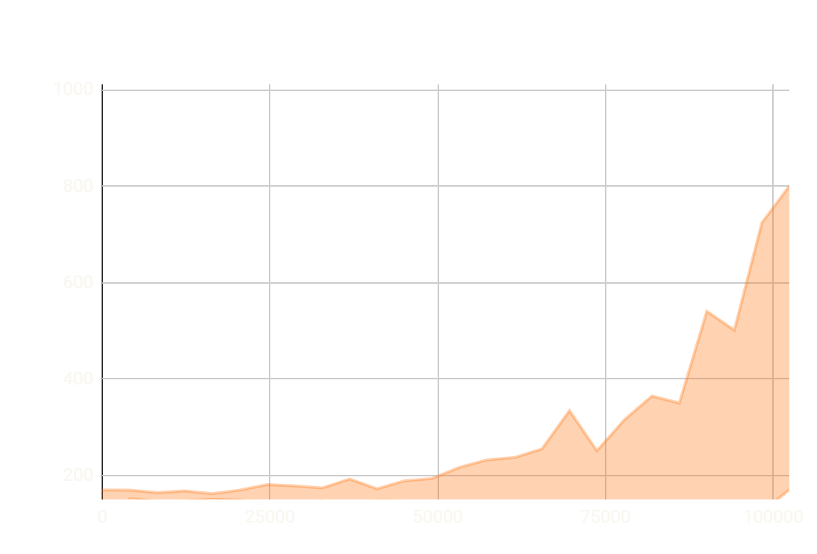
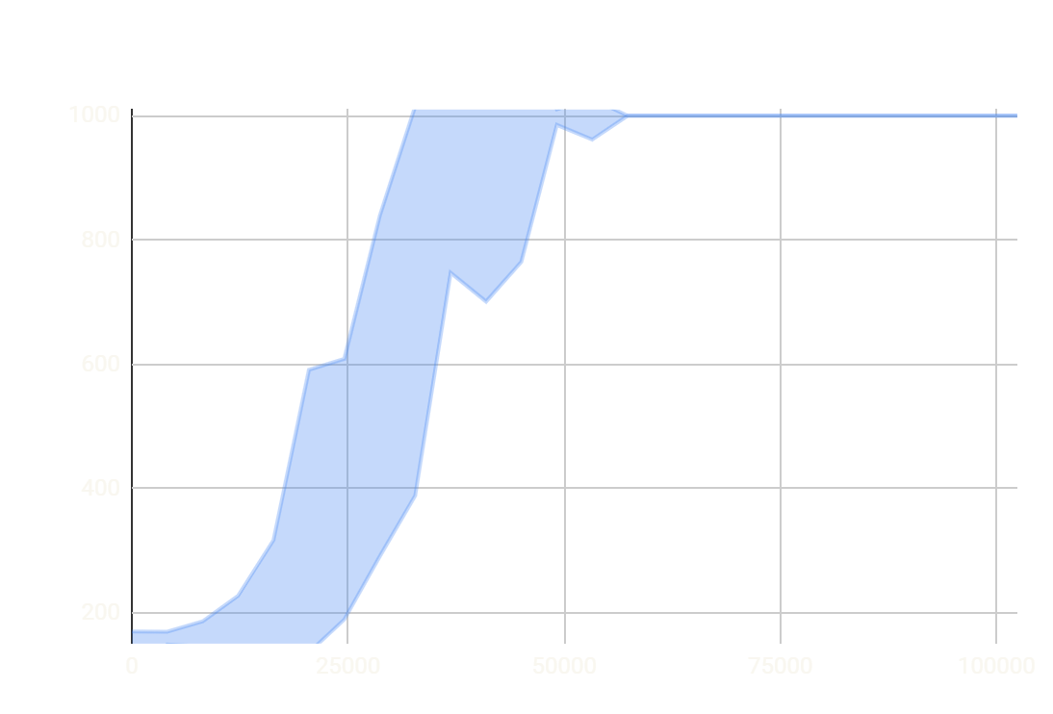
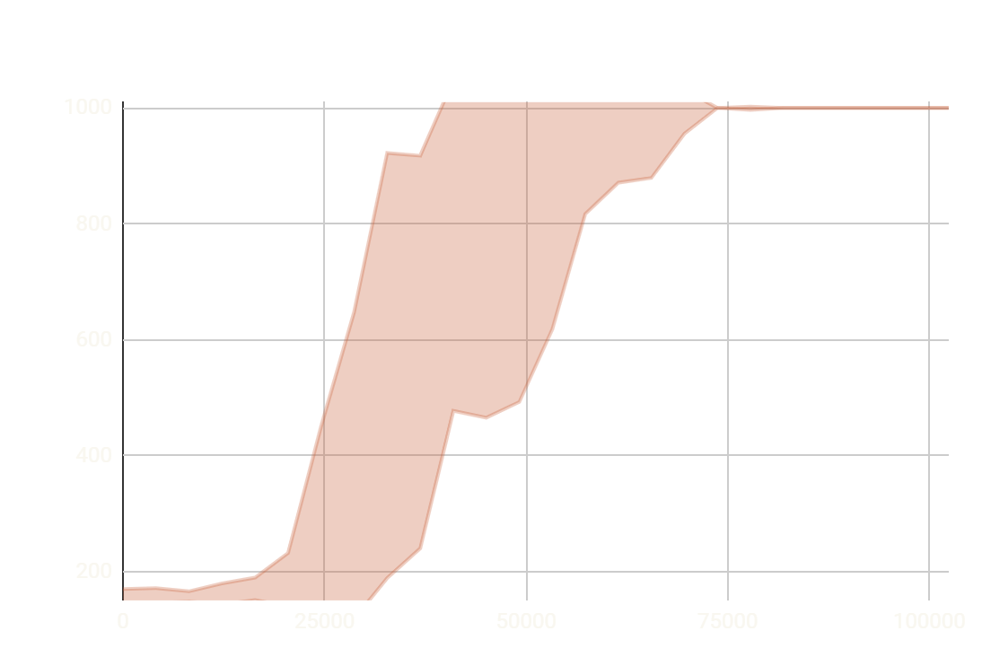
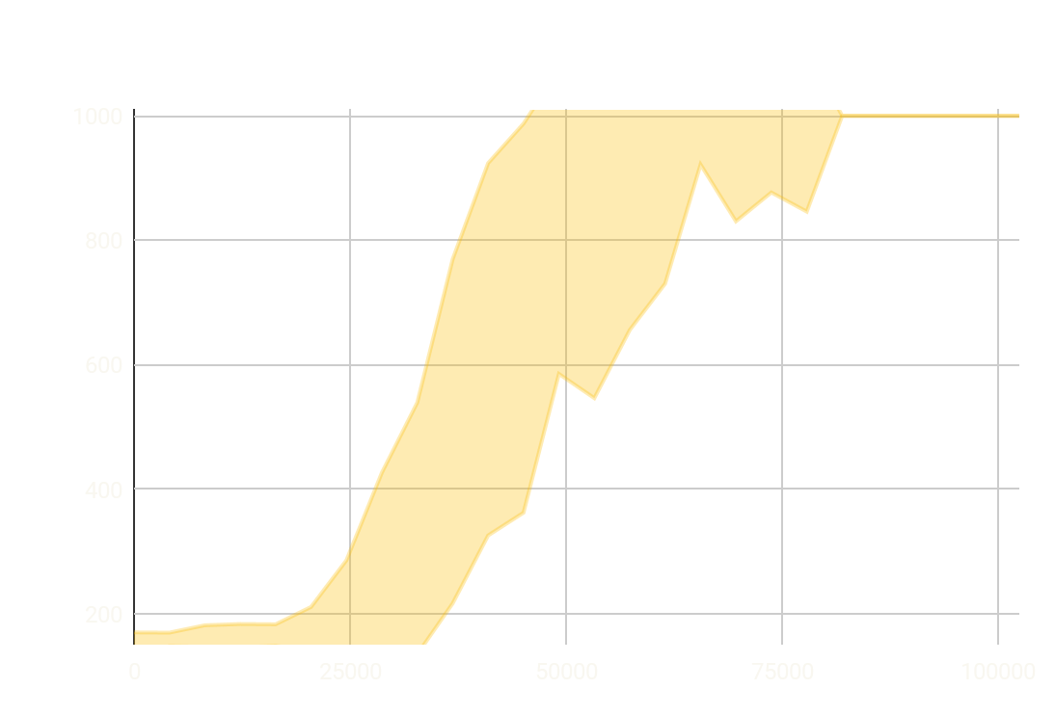
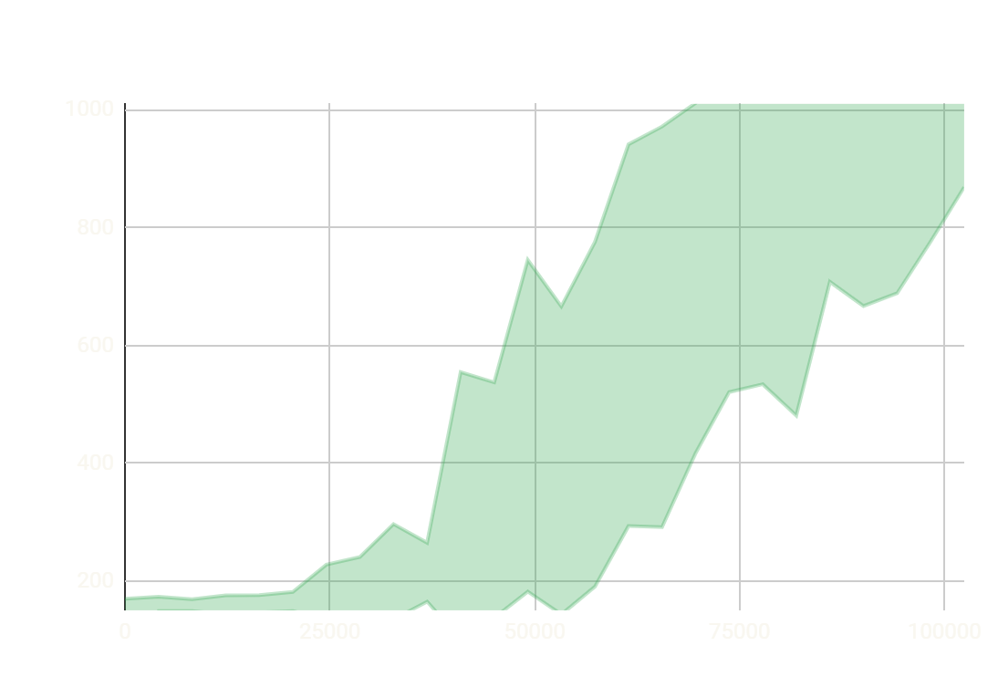
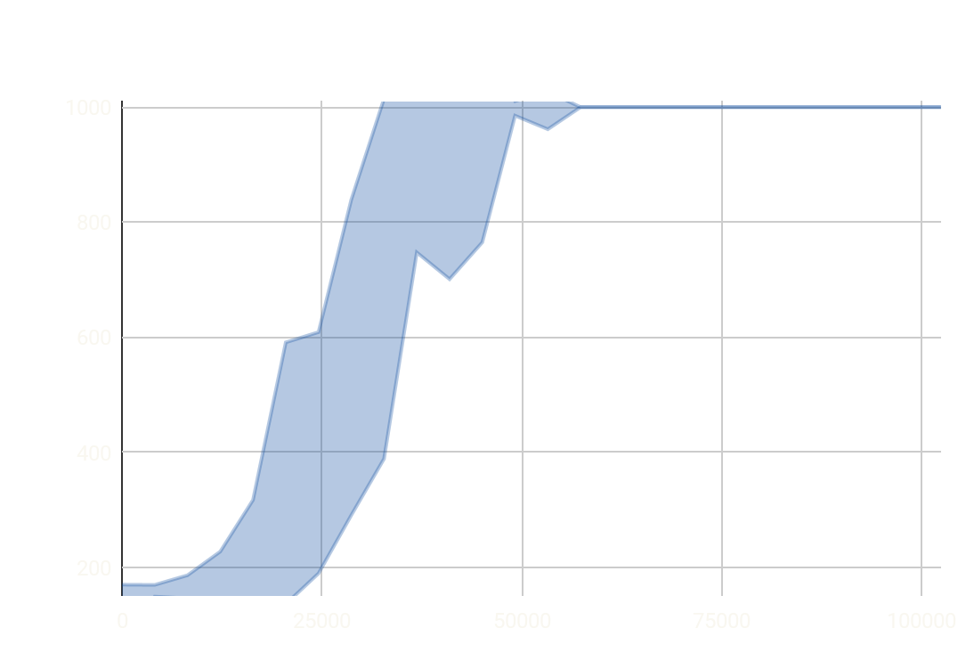
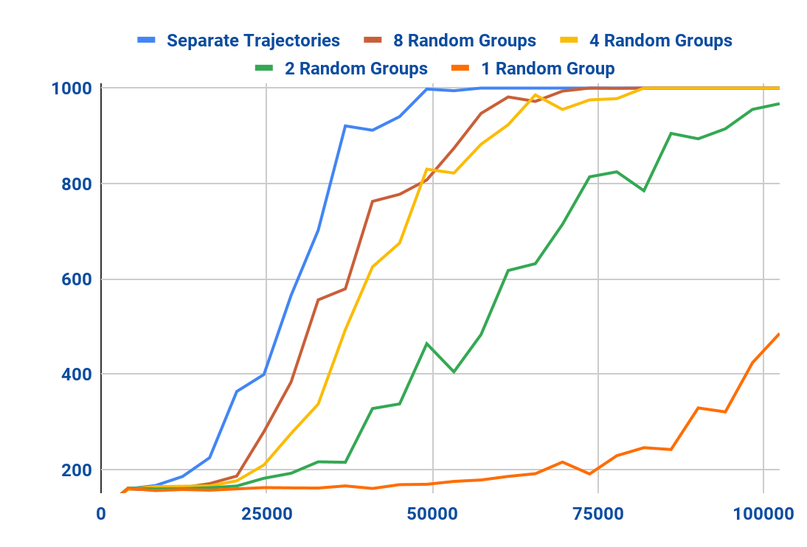
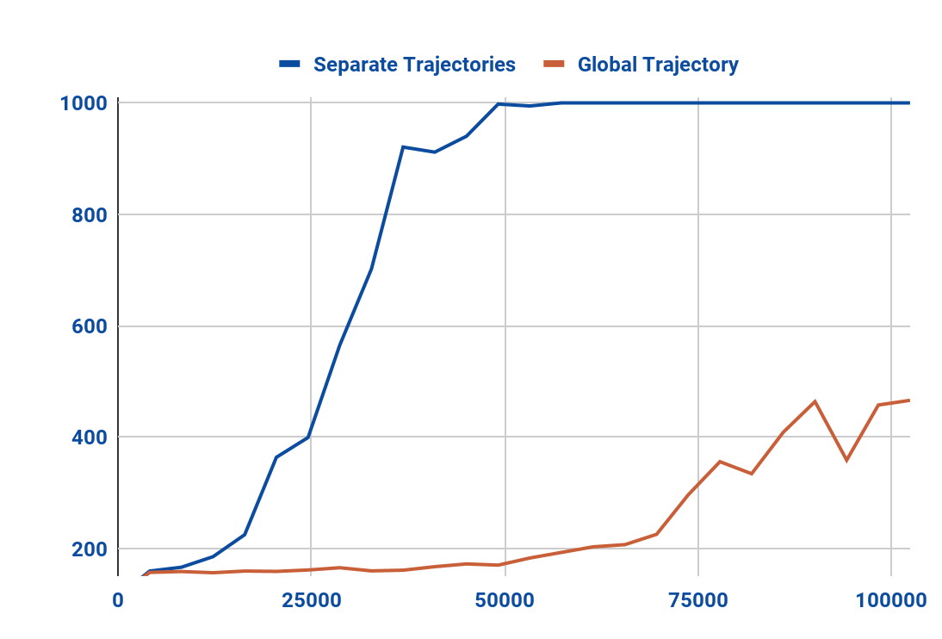
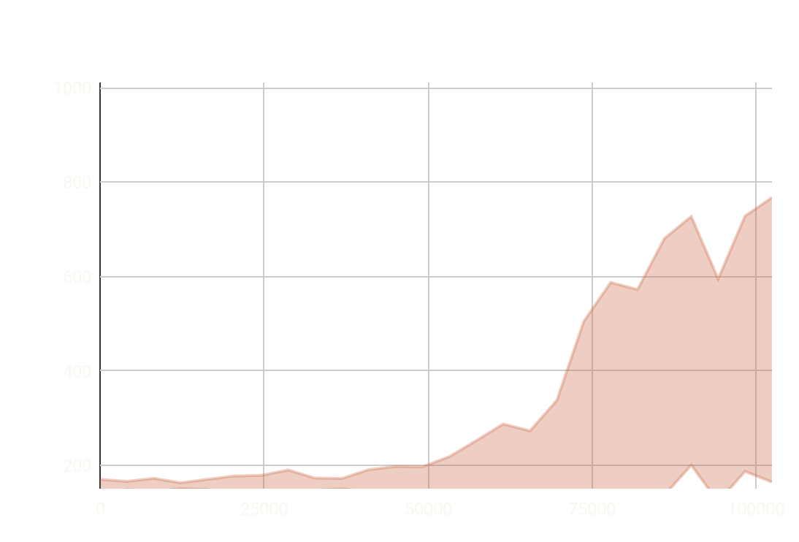
Trajectory Separation Results
Separated vs. Global
Number of Trajectories
Episode Length
Episode Length
Number of Steps
Number of Steps
Results - 3. (Hybrid)
12/15
Notes:
We conducted a lot of experiments, benchmarks and ablation studies to showcase the effectiveness of our method. Unfortunately we can’t show all of them here. So we will focus on the most prominent ones.
On the left you can see a direct comparison between the single trajectory and trajectory separated hybrid architectures.
On the right, we implemented a more general case, where instead of a single or unbounded number of trajectories, we grouped units into N random groups.
Both of the experiments suggest a clear correlation between performance and the number of separate trajectories.

Slide 14
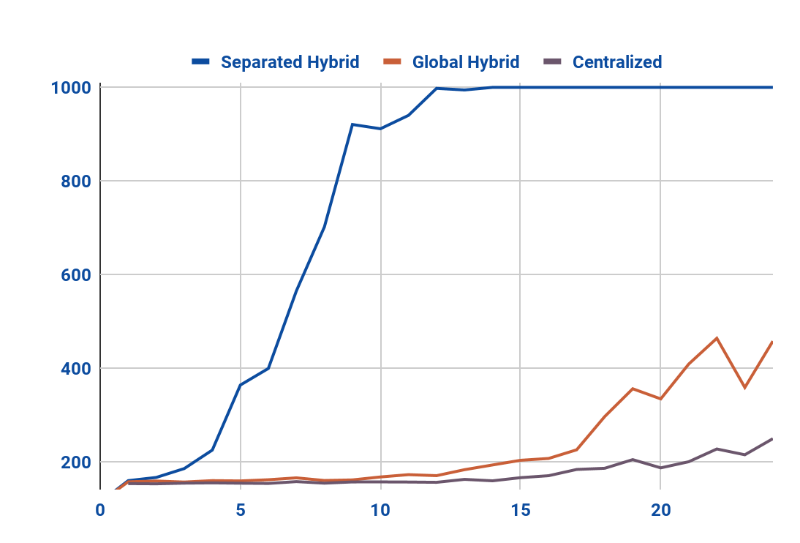
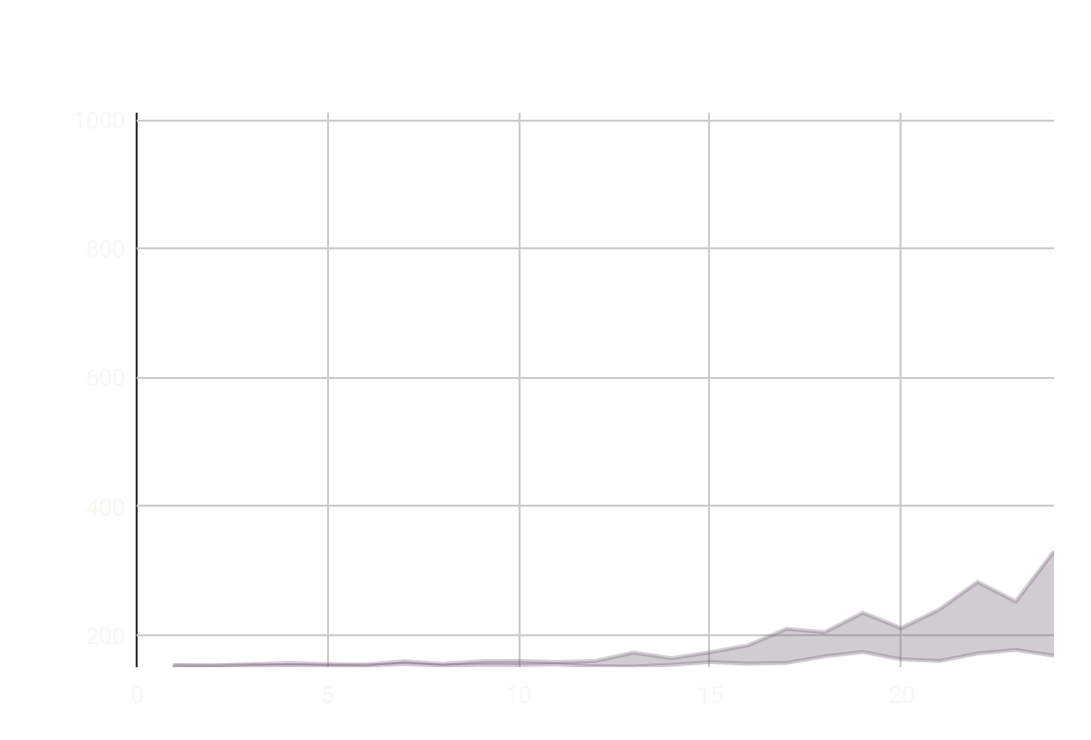
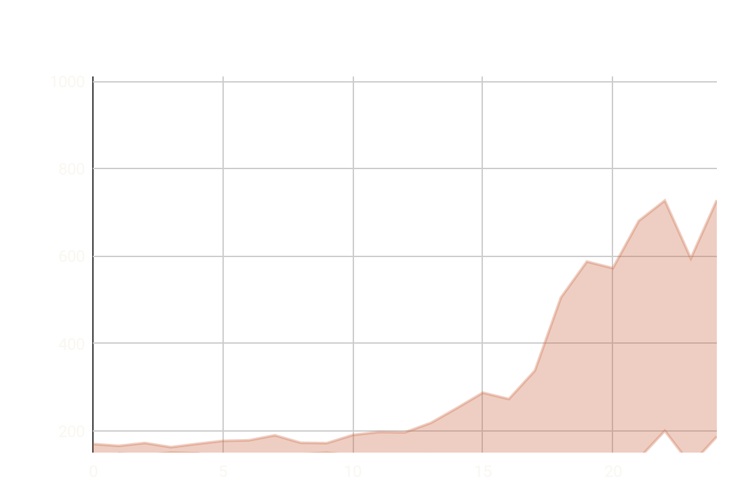
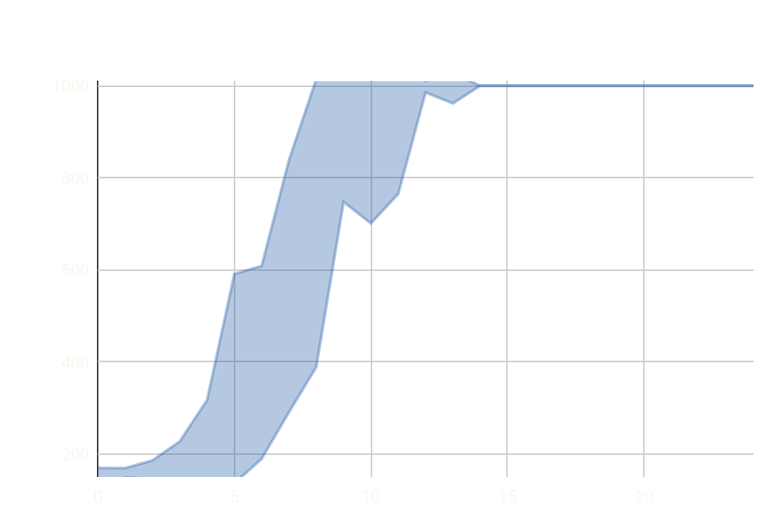
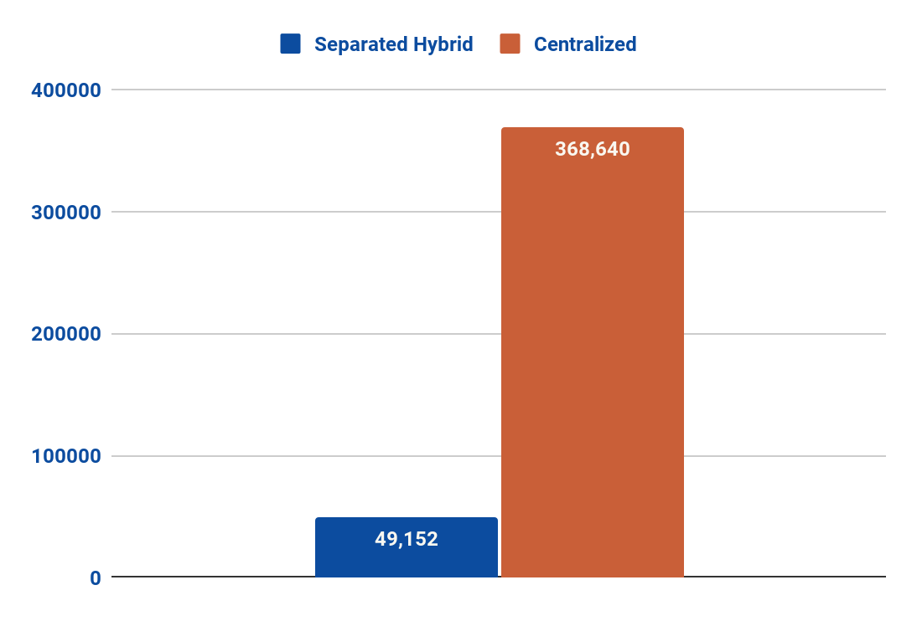
Hybrid vs Centralized
Length of the Episodes
Steps to Reach Max Episode Length*
Episode Length
Number of Steps
Train Epochs
Architectures
Results - 3. (Hybrid) Vs. 2. (Centralized)
13/15
*1,000 Steps, In 95% of Evaluation Environments
Notes:
Next we compared the hybrid model to our initial centralized architecture.
Interestingly, even the single trajectory hybrid architecture performs better with its better game state representation,
But you can see a massive performance boost that comes from enabling trajectory separation. It leads to an over x7 speed increase compared to the centralized model in terms of steps needed to reach the maximum episode length

Slide 15
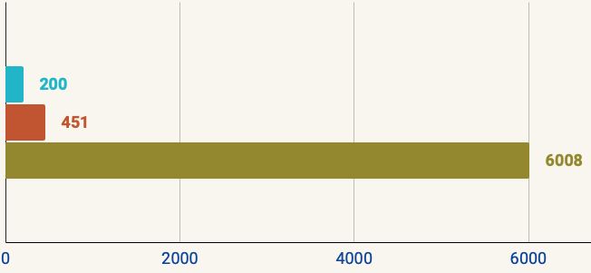
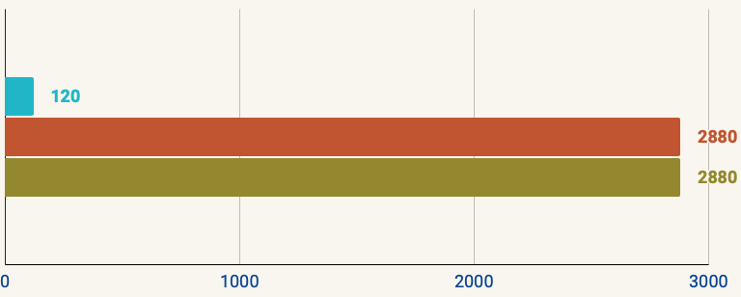
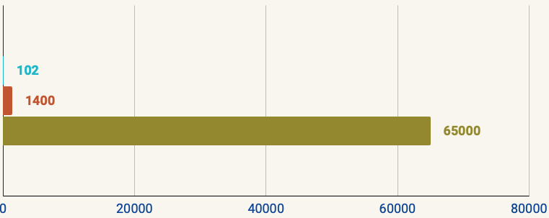
Comparison with Submissions
Best RL Submission (4th Place) [4]
Organizer Baseline [1]
Separated Hybrid (Ours)
x30 Fewer!
x24 Less!
Parameters
Training Time
*
Count (x 1,000) (lower is better)
Minutes (lower is better)
x600 Fewer!
Environment Steps
*
Exact stopping criterion is not known, only the number of steps the model was trained on and the time of training. Training resources also not known.
*
Steps (x 1,000) (lower is better)
Results - 3. (Hybrid) Vs. Related Submissions
14/15
Notes:
[1 min]
Finally, we would like to compare our separated hybrid method with existing submissions for the competition. We compare to 2 of such submissions:
The best performing reinforcement learning submission, which was unfortunately beaten by rule-based approaches and achieved 4th place
Baseline provided by the organizers
We achieved comparable performance with x30 fewer parameters. We managed to train our model 24 times faster in terms of training time and 600 faster in terms of training data needed

Slide 16
Conclusion and Future Work
What We Studied
MARL methods in Lux AI Competition
Resource Efficient MARL Training
Win Next Season!
QR-DQN
Hybrid Architecture with Trajectory Separation
Achievements
x600 Fewer Training Examples
x24 Less Training Time
New Environments
MA-PPO
x30 Fewer Model Parameters
Outro - Conclusion/Future Work
15/15
Notes:
In conclusion, we studied a wide variety of Multi-Agent Reinforcement Learning methods for the Lux AI competition.
We explored different ways multiple agents can be trained in a resource efficient way
Finally, we created a novel architecture that enabled us to train a much smaller model much faster than the best performing RL submission to the competition.
For the future
We want to explore the method of trajectory separation with different algorithms and environments.
Improve upon our existing models with continual learning.
And formalize our method into MA-PPO

Slide 17
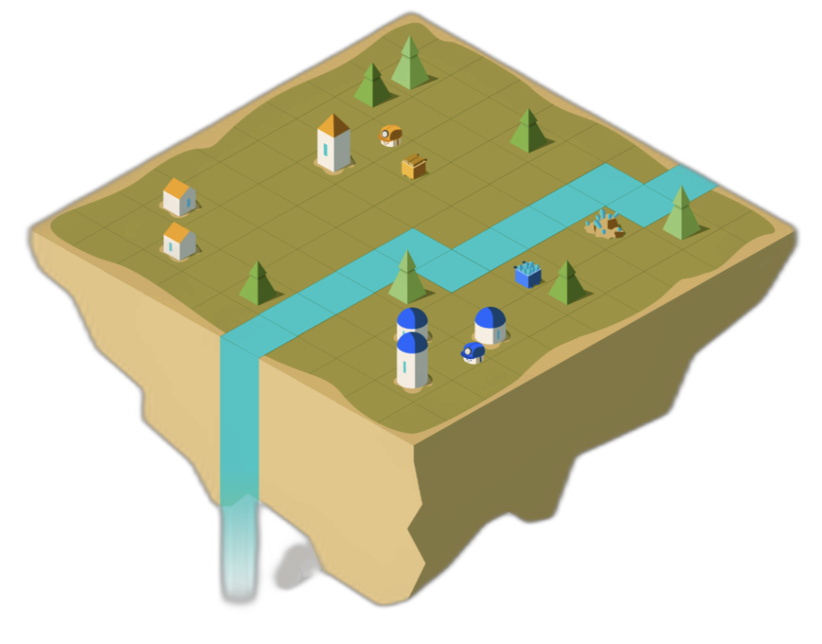





Thank You For Your
Attention!
Outro - Thank You!
Image courtesy of Source [1]
GIF created by our colleague, Imre Molnár
Notes:
TODO

Slide 18
Acknowledgments and References
This work was supported by the Institute for Business Cooperation Scholarship under grants #E111SIVE. We extend our gratitude to our supervisor, László Gulyás, for his extensive efforts, patience, and invaluable guidance, which were crucial throughout this project. We also thank Eötvös Loránd University and the Department of Artificial Intelligence for providing the resources and environment essential for this project's development.
[1]
Tao, S., Li, Q., Jiang, Y., Chen, J., Zhu, X., Doerschuk-Tiberi, B., … Howard, A. (2023). Lux AI Challenge Season 2, NeurIPS Edition. Thirty-Seventh Conference on Neural Information Processing Systems: Competition Track. Retrieved from https://github.com/Lux-AI-Challenge/Lux-Design-S2
[2]
Stone Tao, Isabelle Pan, Bovard Doerschuk-Tiberi, Addison Howard. (2021). Lux AI. Kaggle. https://kaggle.com/competitions/lux-ai-2021
[3]
Stone Tao, Isabelle Pan, Bovard Doerschuk-Tiberi, Addison Howard. (2023). Lux AI Season 2. Kaggle. https://kaggle.com/competitions/lux-ai-season-2
[4]
Limburg, F. (2023). FLG’s Approach. Retrieved from https://www.kaggle.com/competitions/lux-ai-season-2/discussion/406702
[5]
Stefano V. Albrecht, Filippos Christianos, and Lukas Schäfer. Multi-Agent Reinforcement Learning: Foundations and Modern Approaches. MIT Press, 2024.
[6]
Raffin, A., Hill, A., Gleave, A., Kanervisto, A., Ernestus, M., & Dormann, N. (2021). Stable-Baselines3: Reliable Reinforcement Learning Implementations. Journal of Machine Learning Research, 22(268), 1–8. Retrieved from http://jmlr.org/papers/v22/20-1364.html
[7]
Huang, S., & Ontañón, S. (2022). A Closer Look at Invalid Action Masking in Policy Gradient Algorithms. The International FLAIRS Conference Proceedings, 35. doi:10.32473/flairs.v35i.130584
[8]
Chen, H., Tao, S., Chen, J., Shen, W., Li, X., Yu, C., … Li, X. (2023). Emergent collective intelligence from massive-agent cooperation and competition. arXiv [Cs.AI]. Retrieved from http://arxiv.org/abs/2301.01609
Outro - References/Acknowledgments
Notes:
TODO

Slide 19
Questions
One of the lessons of the paper is that the built-in heuristics are vital, e.g. without masking the amount of ice collected is reduced to zero. Sutton argues that similar heuristics become redundant after a while, if -- even years, even decades -- adequate computational capacity is available [1].
Q1: Is this also the case in this task? Is there a theoretical obstacle to abandoning heuristics?
A1: In a deterministic environment like Lux, with unlimited resources and computational power, omitting heuristics will lead to a convergent policy. This means there will be a direct, perfect mapping from each observation to a specific action.
[1]
Sutton, R. S., & Barto, A. G. (2018). Reinforcement learning: An introduction (2nd ed.). The MIT Press.
Extra - Questions
Notes:
TODO

Slide 20
Questions
Q2: Taking this idea one step further, can the contribution of the entire research -- i.e. trajectory separation -- be considered as a heuristic extension of the system in this sense (incorporating human knowledge to compensate for the scarcity of computational capacity)?
A2: In reinforcement learning, the term "heuristics" is broadly defined and can encompass various aspects of system design. It might traditionally refer to aspects of the masking architecture, yet the selection of an algorithm for a specific problem also constitutes a form of heuristic. Even trajectory separation in an RL setting can be viewed as heuristic-based, given this flexible interpretation.
Q3: If we had much more computational capacity, could the full Multi-Agent system work, or is there a principled limitation to it?
A3: Given enough resources, a full Multi-Agent system would also work. However, the Hybrid model offers more than simple resource efficiency, compared to a Multi-Agent system. Having a centralized pixel-to-pixel feature extractor, where entity A can also utilize the features extracted around entity B provides a possible channel for entity-entity communication.
Extra - Questions
Notes:
TODO

Slide 21
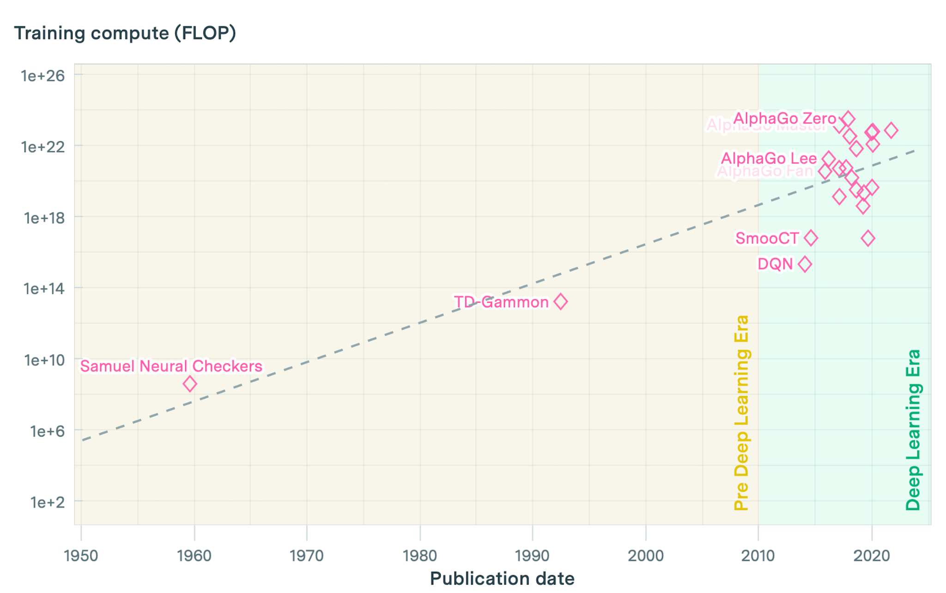
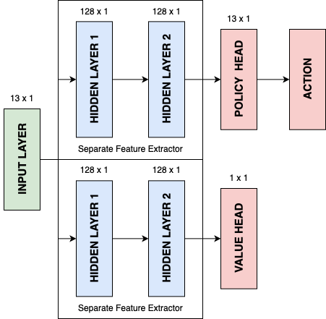
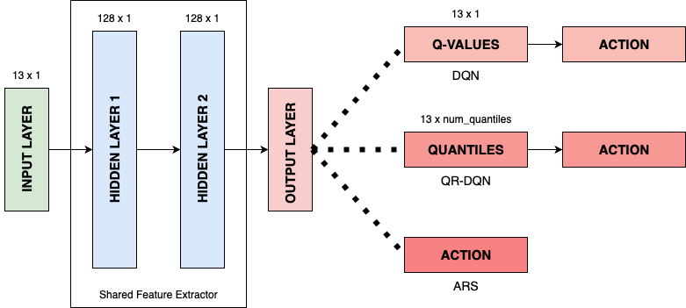
Additional Images
Extra - Images
Notes:
TODO

Slide 22
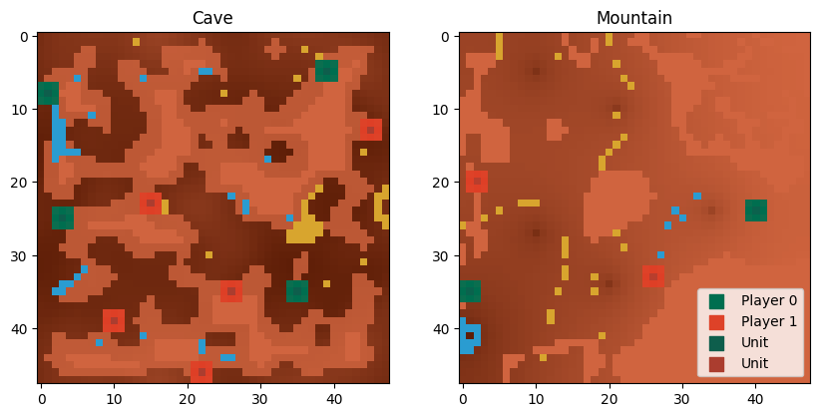
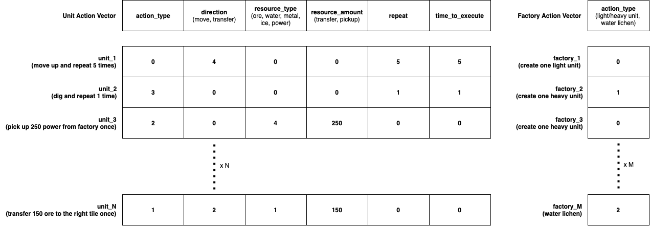
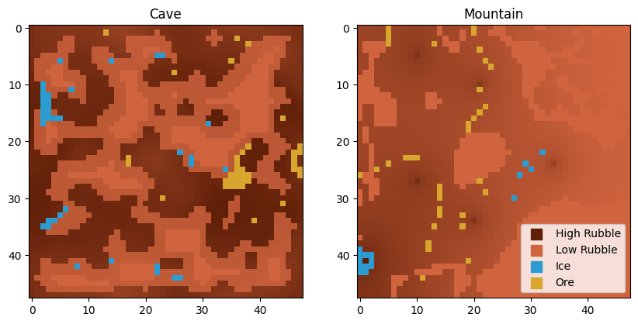
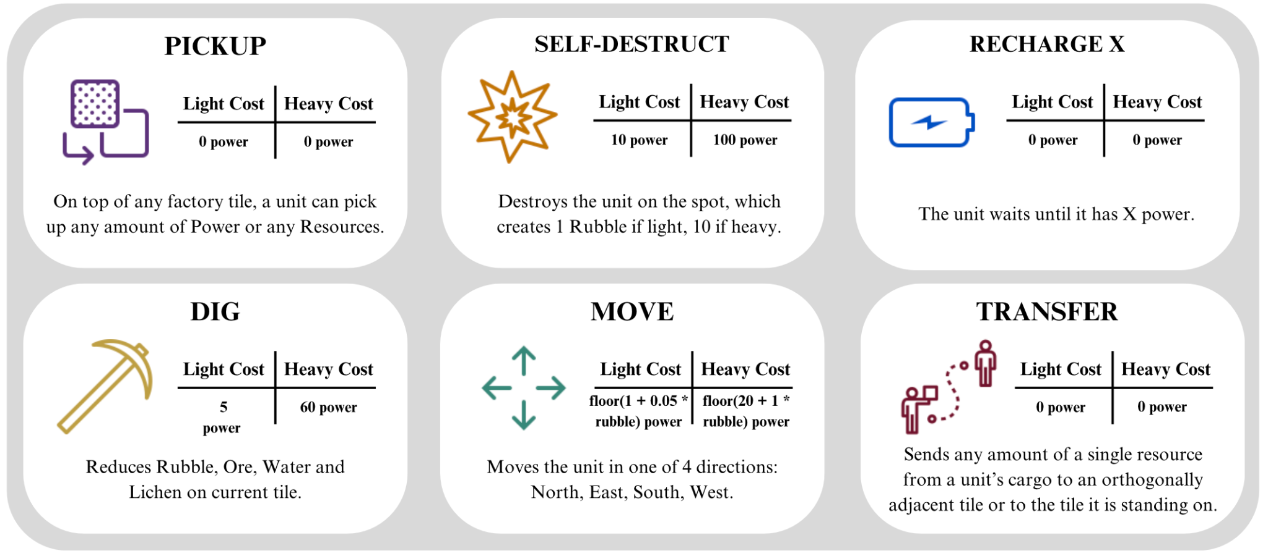
Additional Images
Extra - Images
Notes:
TODO

Slide 23
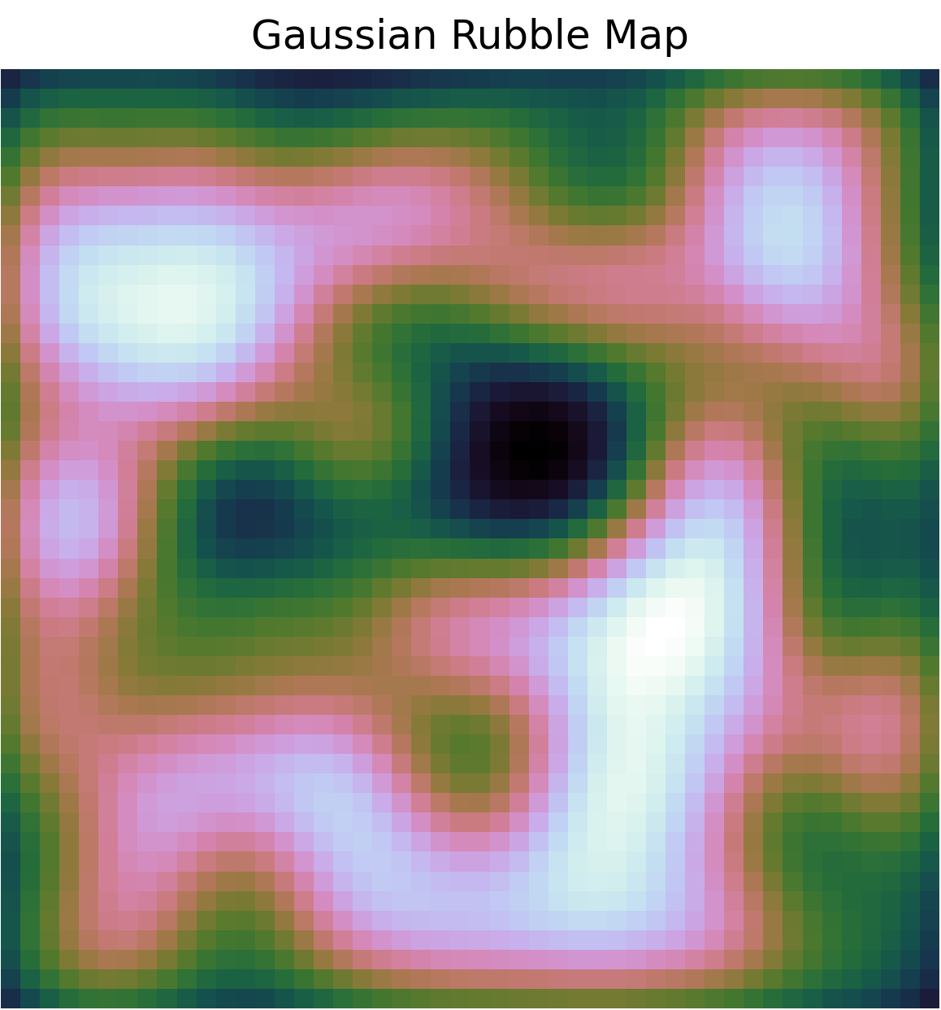
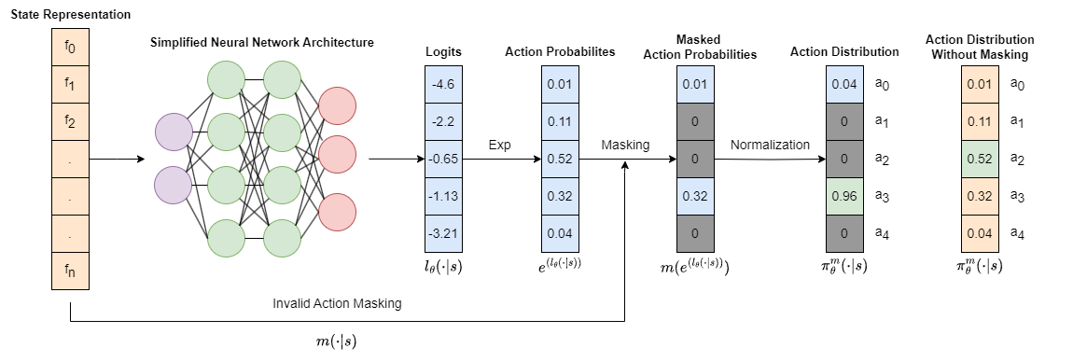
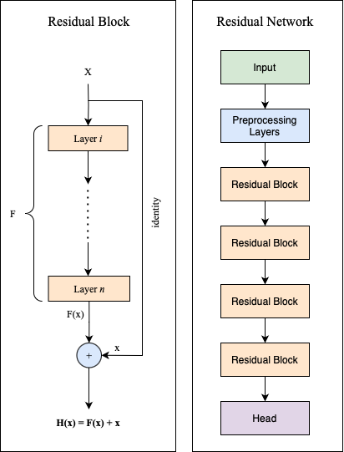


Additional Images
Extra - Images
Notes:
TODO

Slide 24



Additional Images
Extra - Images
Notes:
TODO

Slide 25

Additional Images
Extra - Images
Notes:
TODO

Slide 26



Additional Images
Extra - Images
Notes:
TODO

Slide 27


Additional Images
Extra - Images
Notes:
TODO

Slide 28


Additional Images
Extra - Images
Notes:
TODO

Slide 29
Additional Images
Extra - Images
Notes:
TODO

Slide 30
Related Submissions
Best RL Submission - 4th Place - made by FLG [4]
Single-Agent RL + Imitation Learning
Submissions
6M params - 2 days - 65M steps
Baseline RL Solution - provided by the organizers [1]
Single-Agent RL
Rule-Based
Imitation Learning
451K params - 2 days - 1.4M steps
Reinforcement Learning
Basis of Comparison:
Learning to Reach Maximum Episode Length (1,000 Environment Steps)
Single-Agent (Centralized)
Multi-Agent
Introduction - Related Works
Notes:
The competition was dominated by Rule-Based approaches, where every single entity was controlled heuristically. Ultimately these methods won the competition.
Unfortunately the best RL based submission only came in 4th place and it relied heavily on Imitation Learning for architecture search.
They used a single-agent method, where the single agent was the team, and every entity became part of a very complex multi-action space.
Since we couldn’t participate in the competition itself due to time issues, we couldn’t directly play our models against the submissions, so we had to come up with a method of comparison. We chose reaching maximum episode length as this milestone.
You can see that the best submission took 65M steps of data and 2 days of training to reach this state.
We also compare our methods to a baseline that was provided by the organizers. This baseline also used the Single-Agent method.

Slide 31

1.
Maskable PPO [7]
Environment easily parallelizable
Agent trajectories easily parallelizable
Best performant in our benchmark study.
Perfect Candidate for Multi-Agent RL Tasks
The M in M-PPO
Observation State
Representation
Action
Distribution
w/ Masking
Action
Distribution
w/o Masking
Simplified NN
Architecture
Action
Probabilities
Masked
A.P.
Logits
a₀
a₀
a₁
a₁
Exp
Masking
Normalize
a₂
a₂
a₃
a₃
a₄
a₄
Invalid Action Masking
Reduced action space!
Methods - 1. RL Algorithm Best Model Selection
Notes:
TODO

